Slide 1
Sports Resources Booking Application

Slide 2
Web:
Aditi Indoori - 160118737001 -2nd year-IT
Akshitha - 160117733001 - 3rd year -CSE
Varun - 160117733115 -3rd year -CSE
Database and API:
Sai Prathyusha G - 160118733012 -2nd year CSE
Annanya Vedala - 160118733011 -2nd year CSE
Android:
Koppula Sai Charan - 160119733103 - 1st year -CSE
Amith Reddy - 160119733082 - 1st year -CSE
Garigaboina Revanth - 160119733161 - 1st year- CSE
TEAM - 04

Slide 3
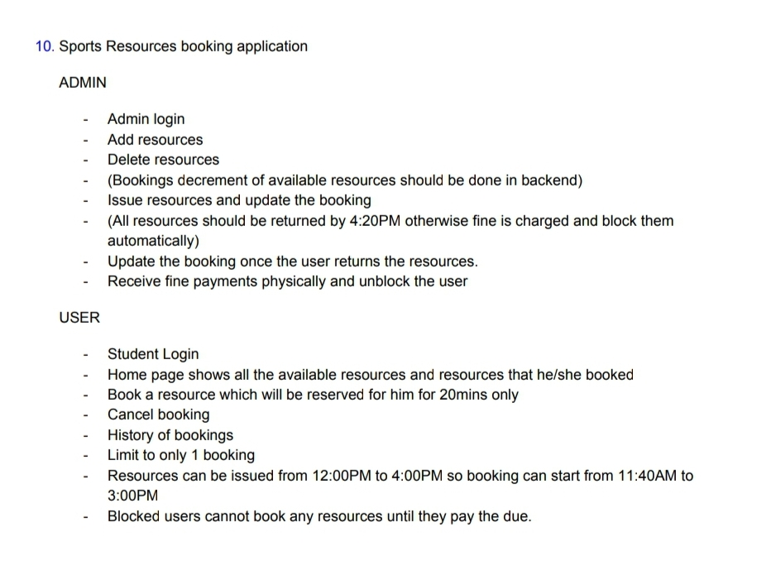
Problem Statement

Slide 4
Technology Stack
Web
Html,CSS
Bootstrap
Javascript
Django
Android
Java
Xml
RESTFul API
Flask

Slide 5
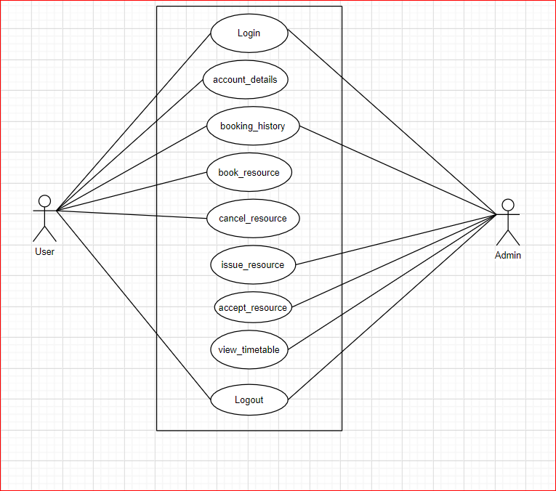
UseCase Diagram

Slide 6
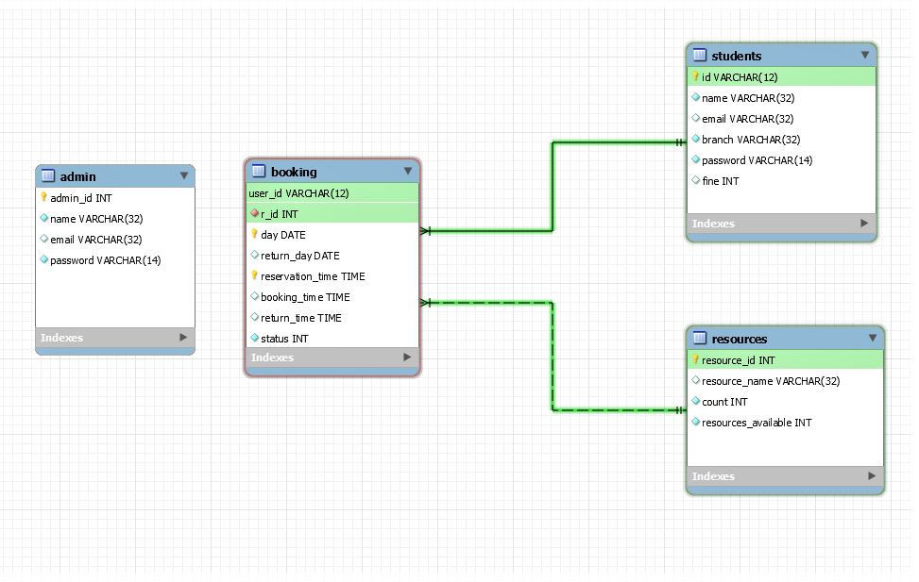
Entity Relationship Diagram

Slide 7
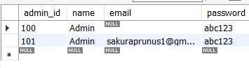
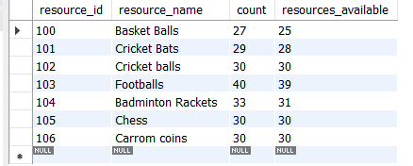
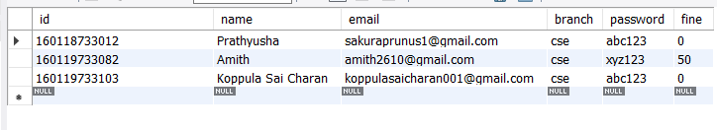
Database Design
Admin table
Resources table
Students table

Slide 8
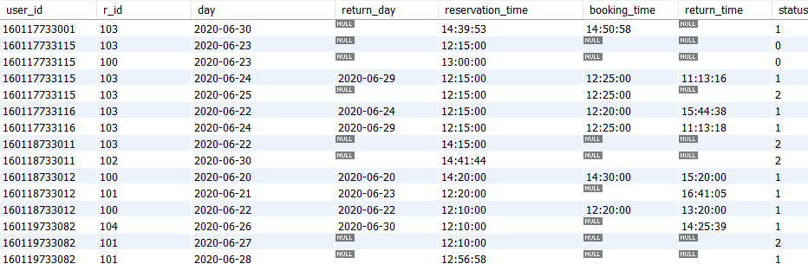
Database Design
Booking table

Slide 9
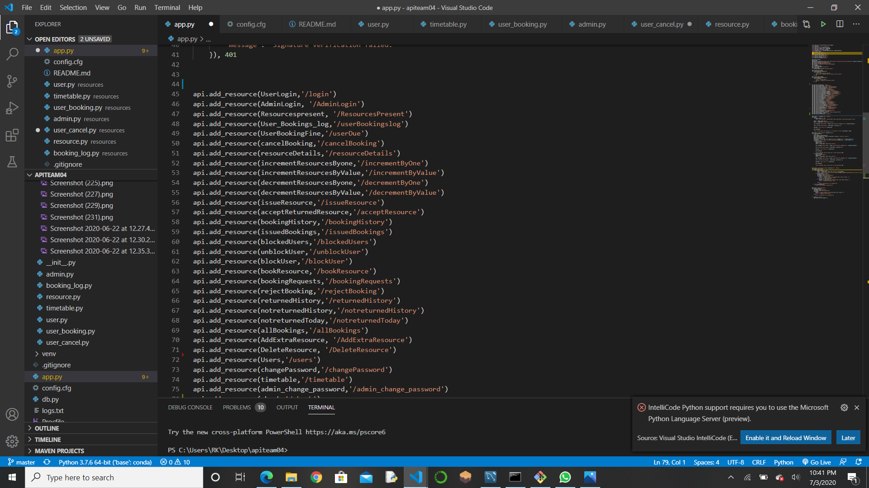
FEATURES OF THE API
This API is hosted on heroku and is ready
to respond to the requests.
It will be just enough to write HTML,CSS,
JS and send requests to the API ,which
will respond with the expected output

Slide 10
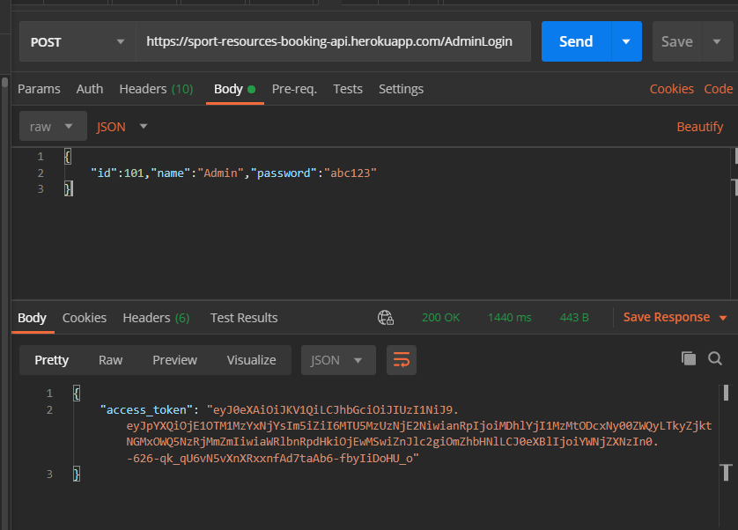
FEATURES OF THE API
For the login authentication system,
The API will respond to a successful login request with a token for the user to identify or if it lacks valid authentication credentials it responds with a 401 status code.

Slide 11
Web Application

Slide 12
Web Application
WEB APPLICATION
Features for the Administrator :
Adding and deleting the resource when required.
Accepting or rejecting the resource requested by the user based on the timetable.
Updating the booking depending on whether the resources were returned or not and imposing fines accordingly.
Blocking the user if the resource is damaged.
Collecting fine manually and unblocking the user.

Slide 13
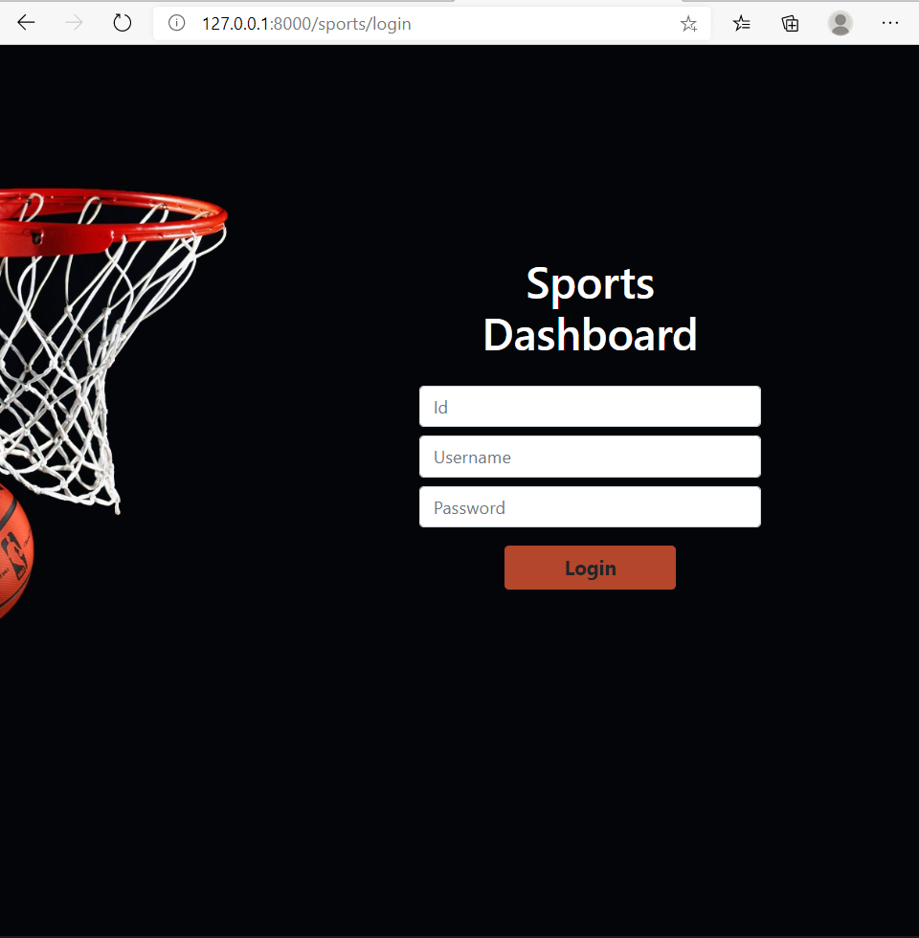
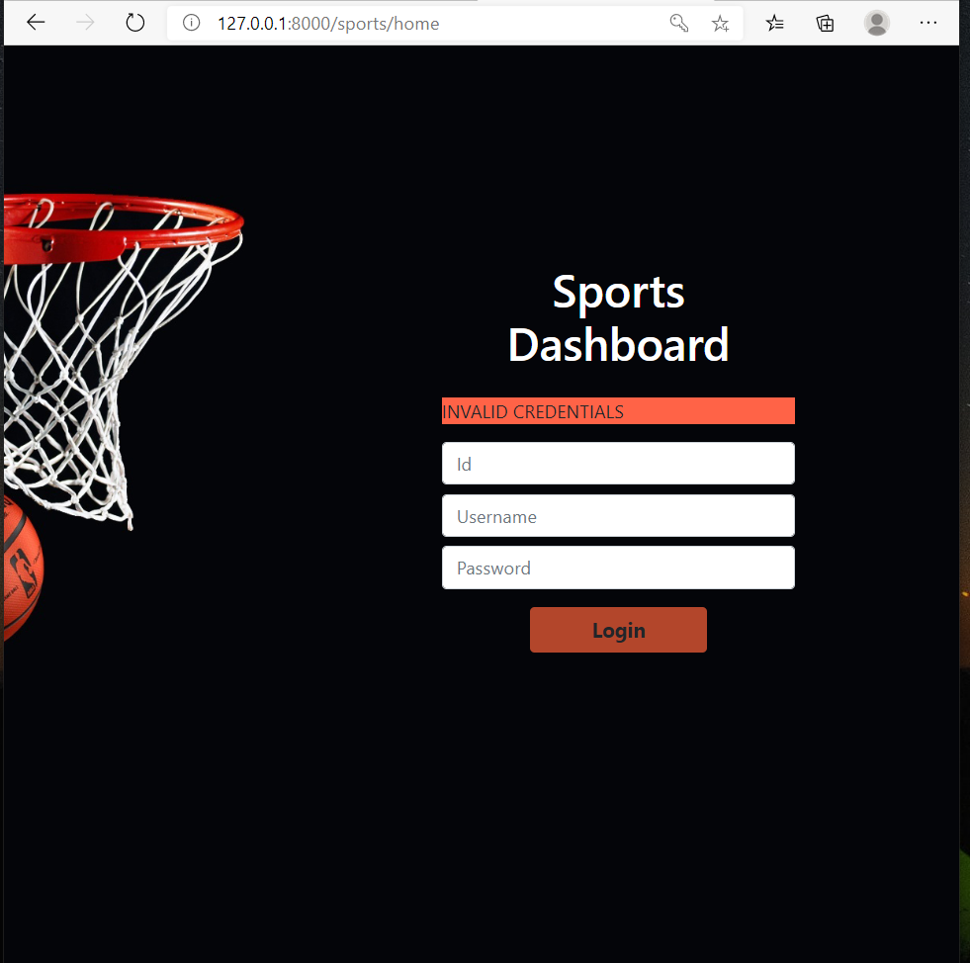
Admin Login : The Admin has to enter the correct credentials i.e Id,name and password to login.
Invalid Login: If the admin enters wrong credentials this page is viewed which says that the entered credentials are wrong.

Slide 14
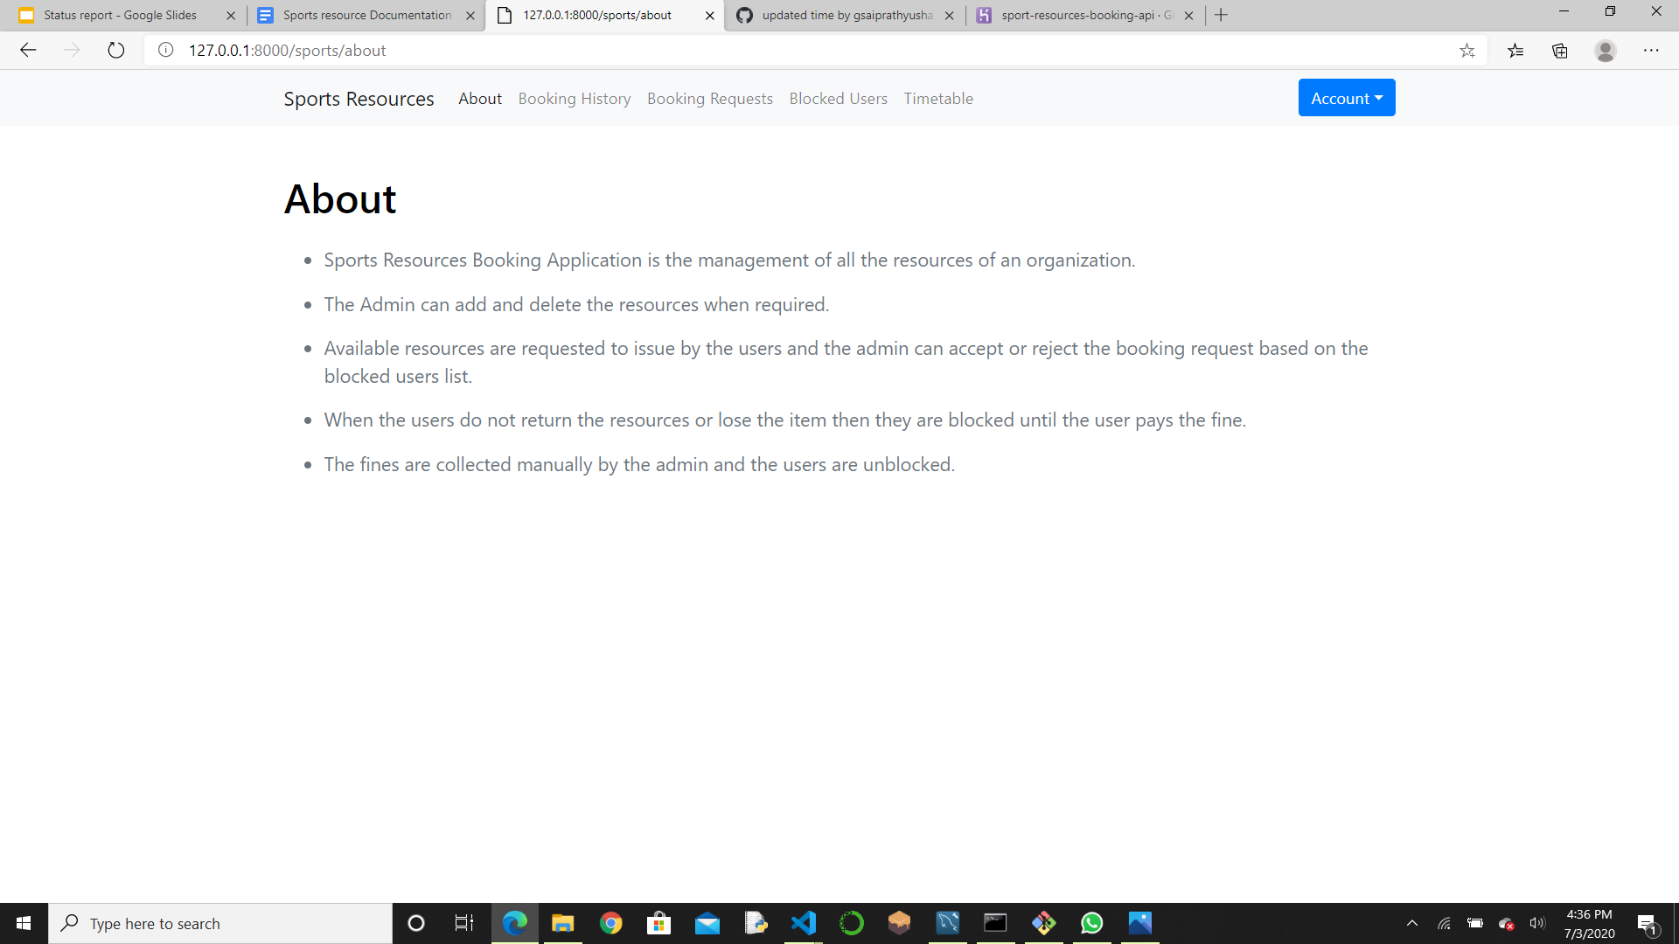
About : Information about the features of this web application i.e.,what all can be done by the admin.

Slide 15
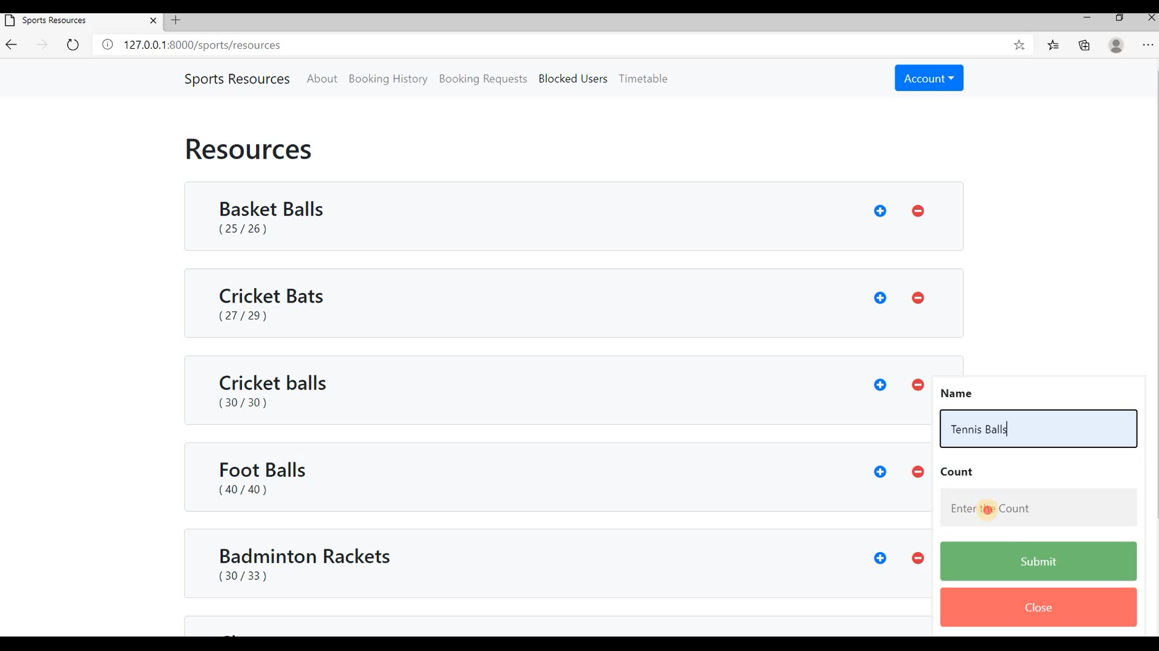
Resources: All the available resources are shown and admin can add or delete resources by clicking on the plus and minus icons beside the resources.

Slide 16
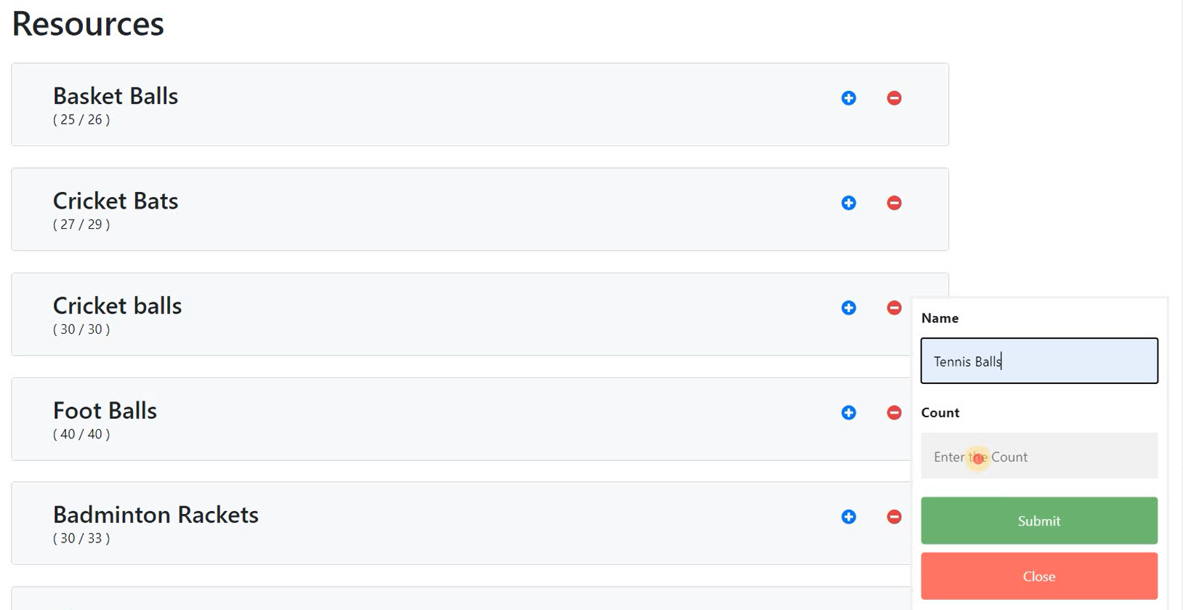
API ENDPOINTS USED IN THE AVAILABLE RESOURCES
/incrementByValue
Increments the resources available and total resources by 1
Used to increment the count when any new resources are bought by the administration
/decrementByValue
Decrements the available resources and total resources by 1
Used to decrement count when any resources are damaged
/addExtraRessource
To add a new resource to the database
/resourcesPresent(GET)
Fetches the details of all the resources present

Slide 17
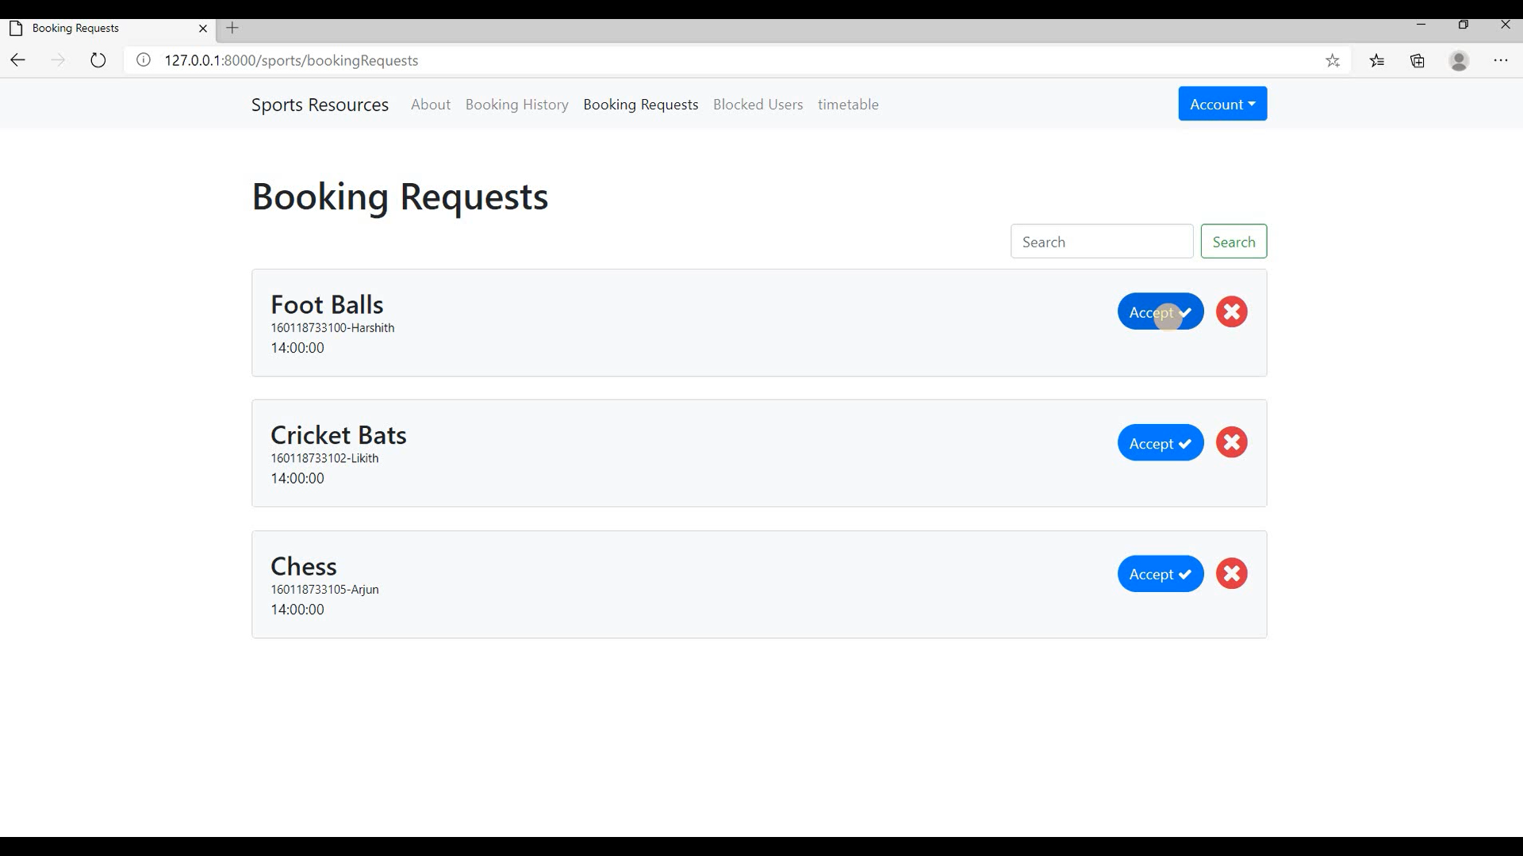
Booking Requests: All the requests from the users are shown here. Admin can either accept the request or reject the request.

Slide 18
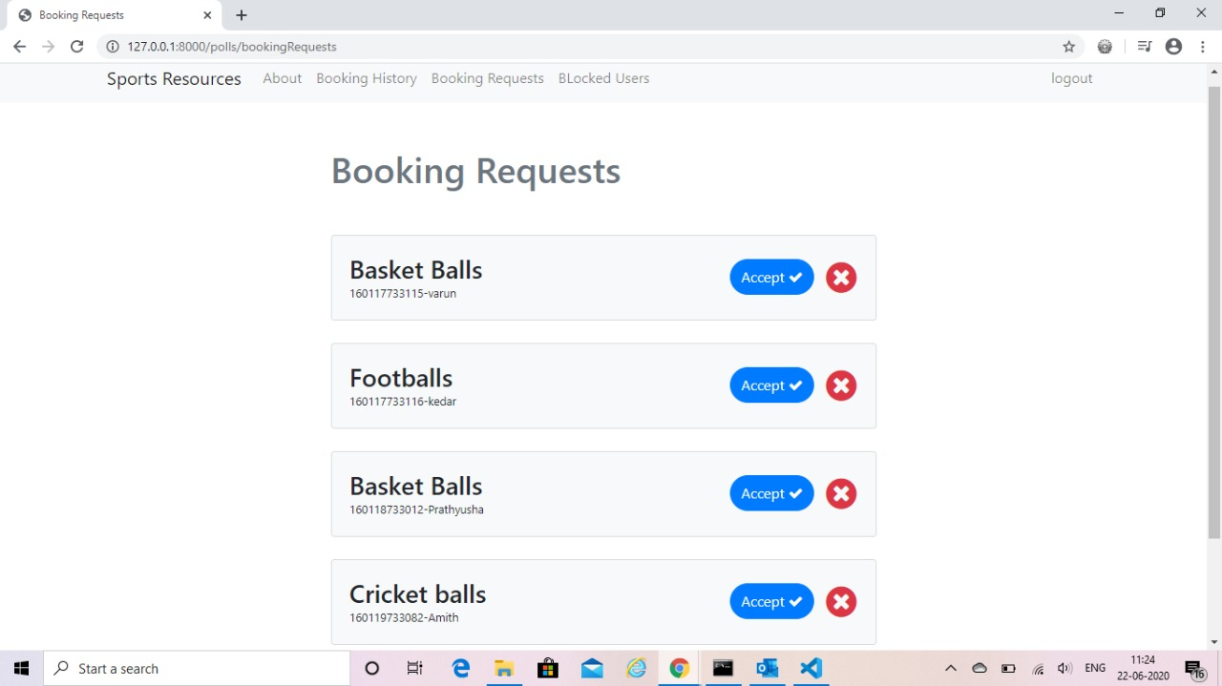
API ENDPOINTS USED IN THE BOOKING REQUESTS
/bookingRequests(GET)
Used to return the booking requests of current day
It will automatically reject booking requests which are not collected by the user after 20 minutes
/issueBooking
Resource will be issued if the user doesn’t have any due
UPdates the issue time and decrements available resources count
Request will be rejected automatically if there are no available resources
/rejectBooking
It will reject the booking of a user and updates the database

Slide 19
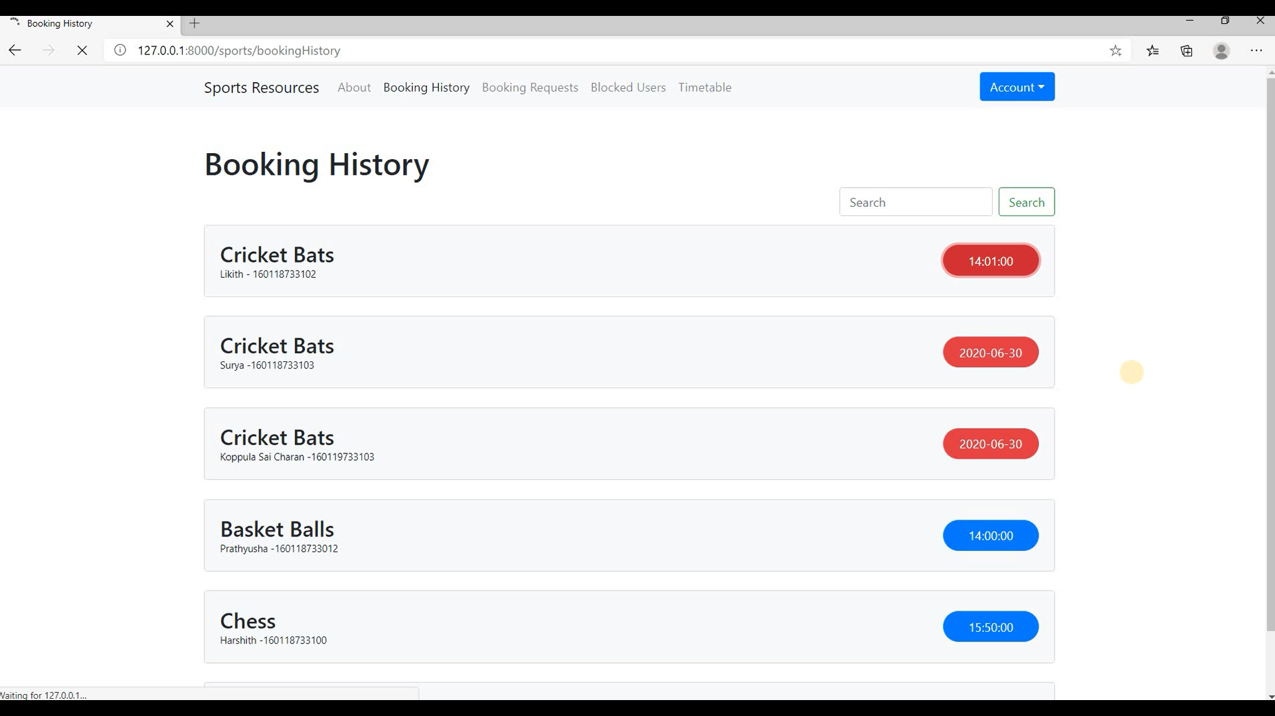
Booking History: Shows the details of all the resources which are booked by the users.

Slide 20
API ENDPOINTS USED IN THE BOOKING HISTORY
/notreturnedHistory(GET)
Used to return the details of booking,which are not returned till now.
/returnedHistory (GET)
Used to return the history of bookings of current day
/acceptResource
Used to update the fine,return time,date automatically when a user returns a resource.

Slide 21
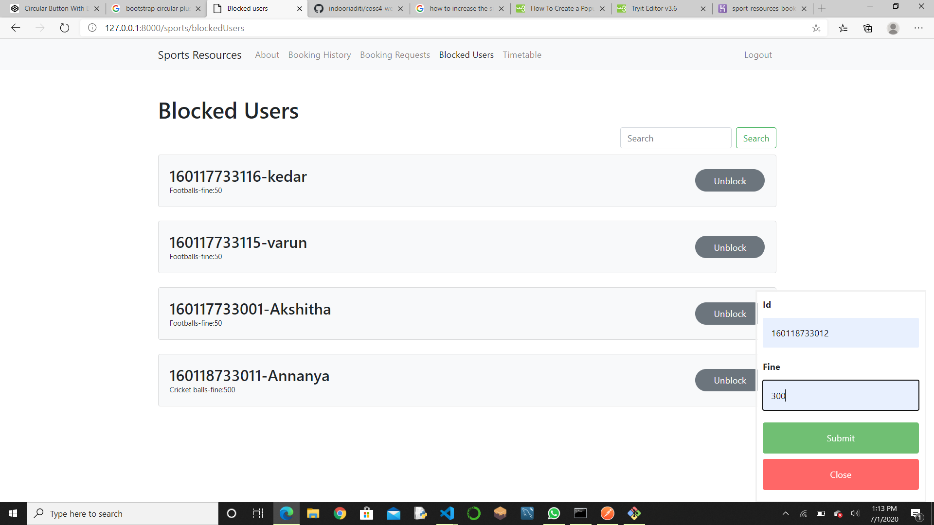
Blocked Users: Shows the list of blocked users and an option to unblock them.

Slide 22
API ENDPOINTS USED IN THE BLOCKED USERS
/blockedUsers
It will return the details of the user and booking for which the fine has been imposed .
/unblockUser
Unblocks a user when the user clears the due.
/blockUser
Blocks a user so that he cannot make any further bookings by imposing fine

Slide 23
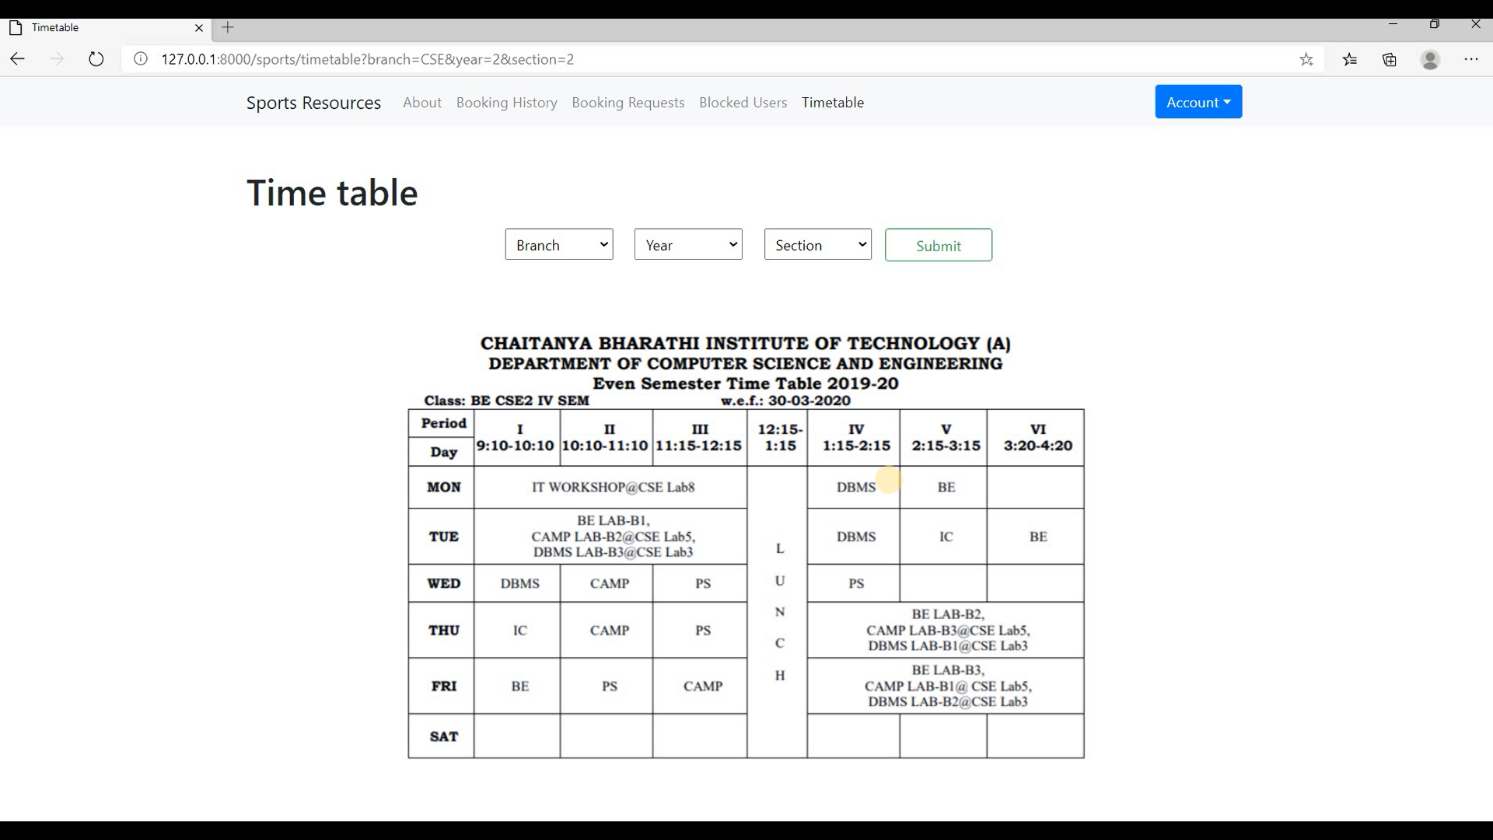
Timetable: Admin can view the timetable of any class by entering the branch, section and year.

Slide 24
Android Application

Slide 25
Features for User
Can view all the resources available in the sports block with its count in the app. This reduces the enquiry time at the issue counter.
He can send a booking request with just one click so that he can collect it in 20 minutes from his booking time.
User also has an option to cancel the booking request within 20 minutes of the booking time.
User can view all his past booking requests with their status so that he can know what requests he made.
User has an option to set his password to a new one when he forgets his password or wants to change it.

Slide 26
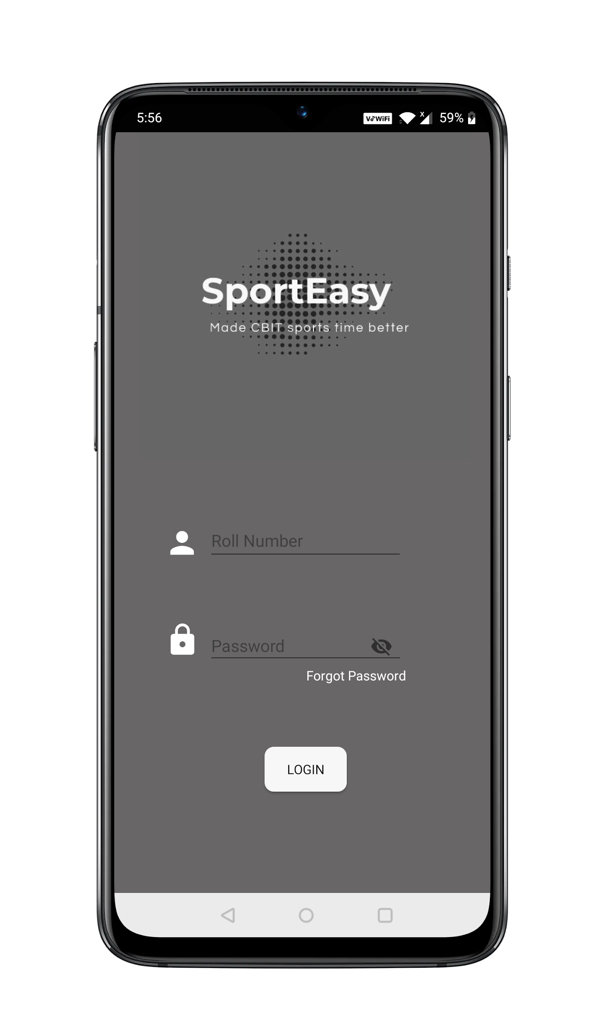
LOGIN ACTIVITY

Slide 27
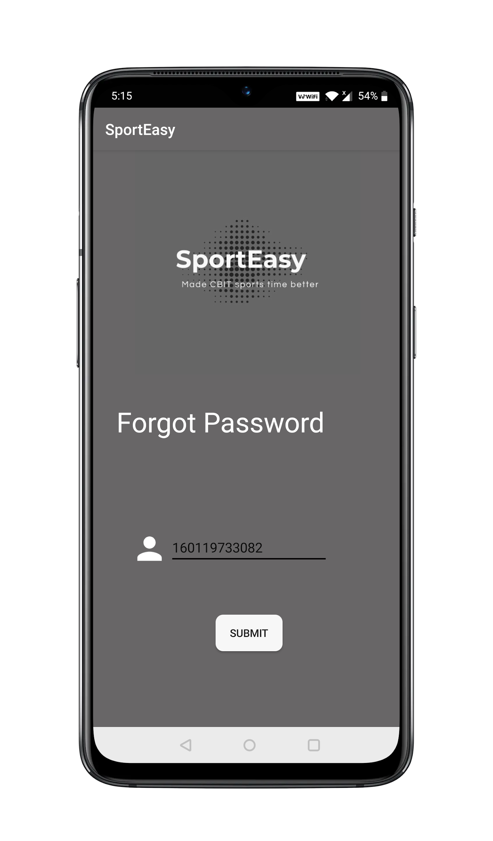
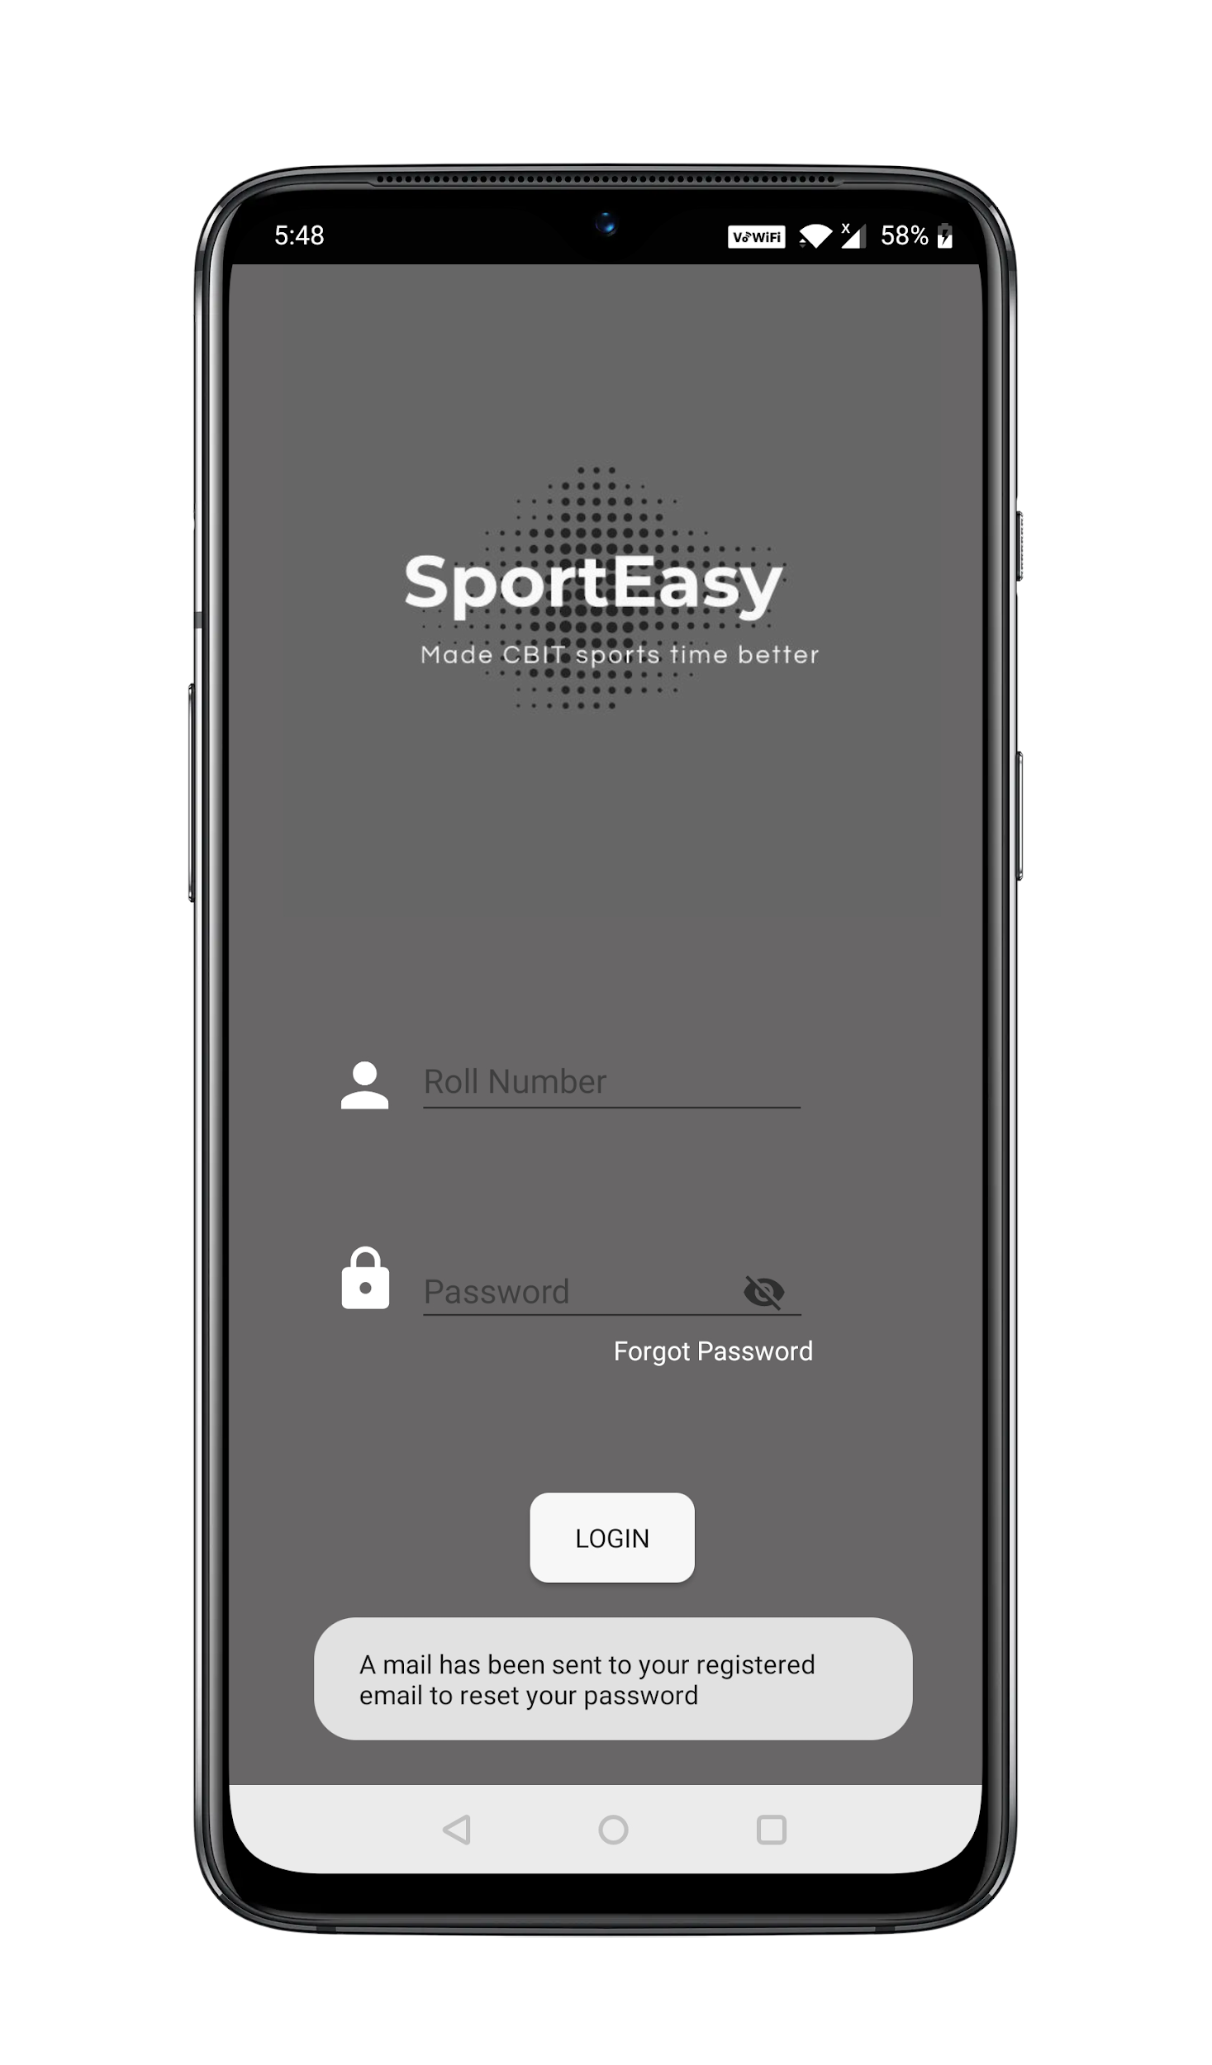
Forgot Password
In case a user forgets his password,he can reset it using a mail sent to his registered email address.

Slide 28
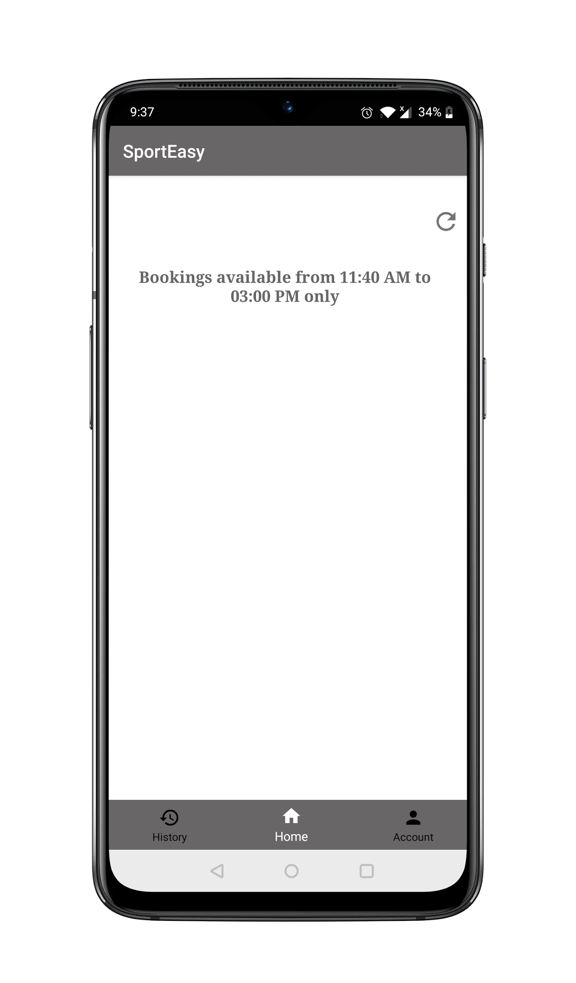
User gets to book the resources only in time slot provided.

Slide 29
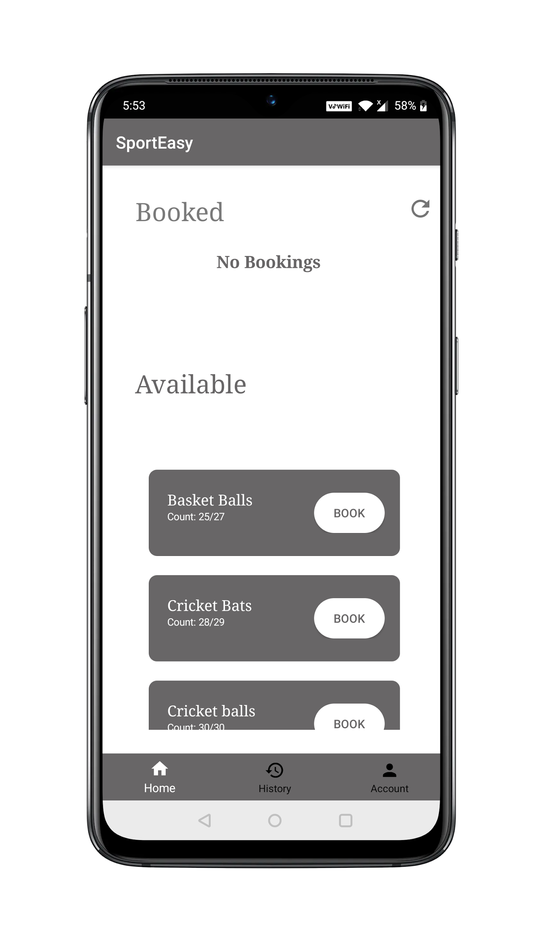
Home Activity

Slide 30
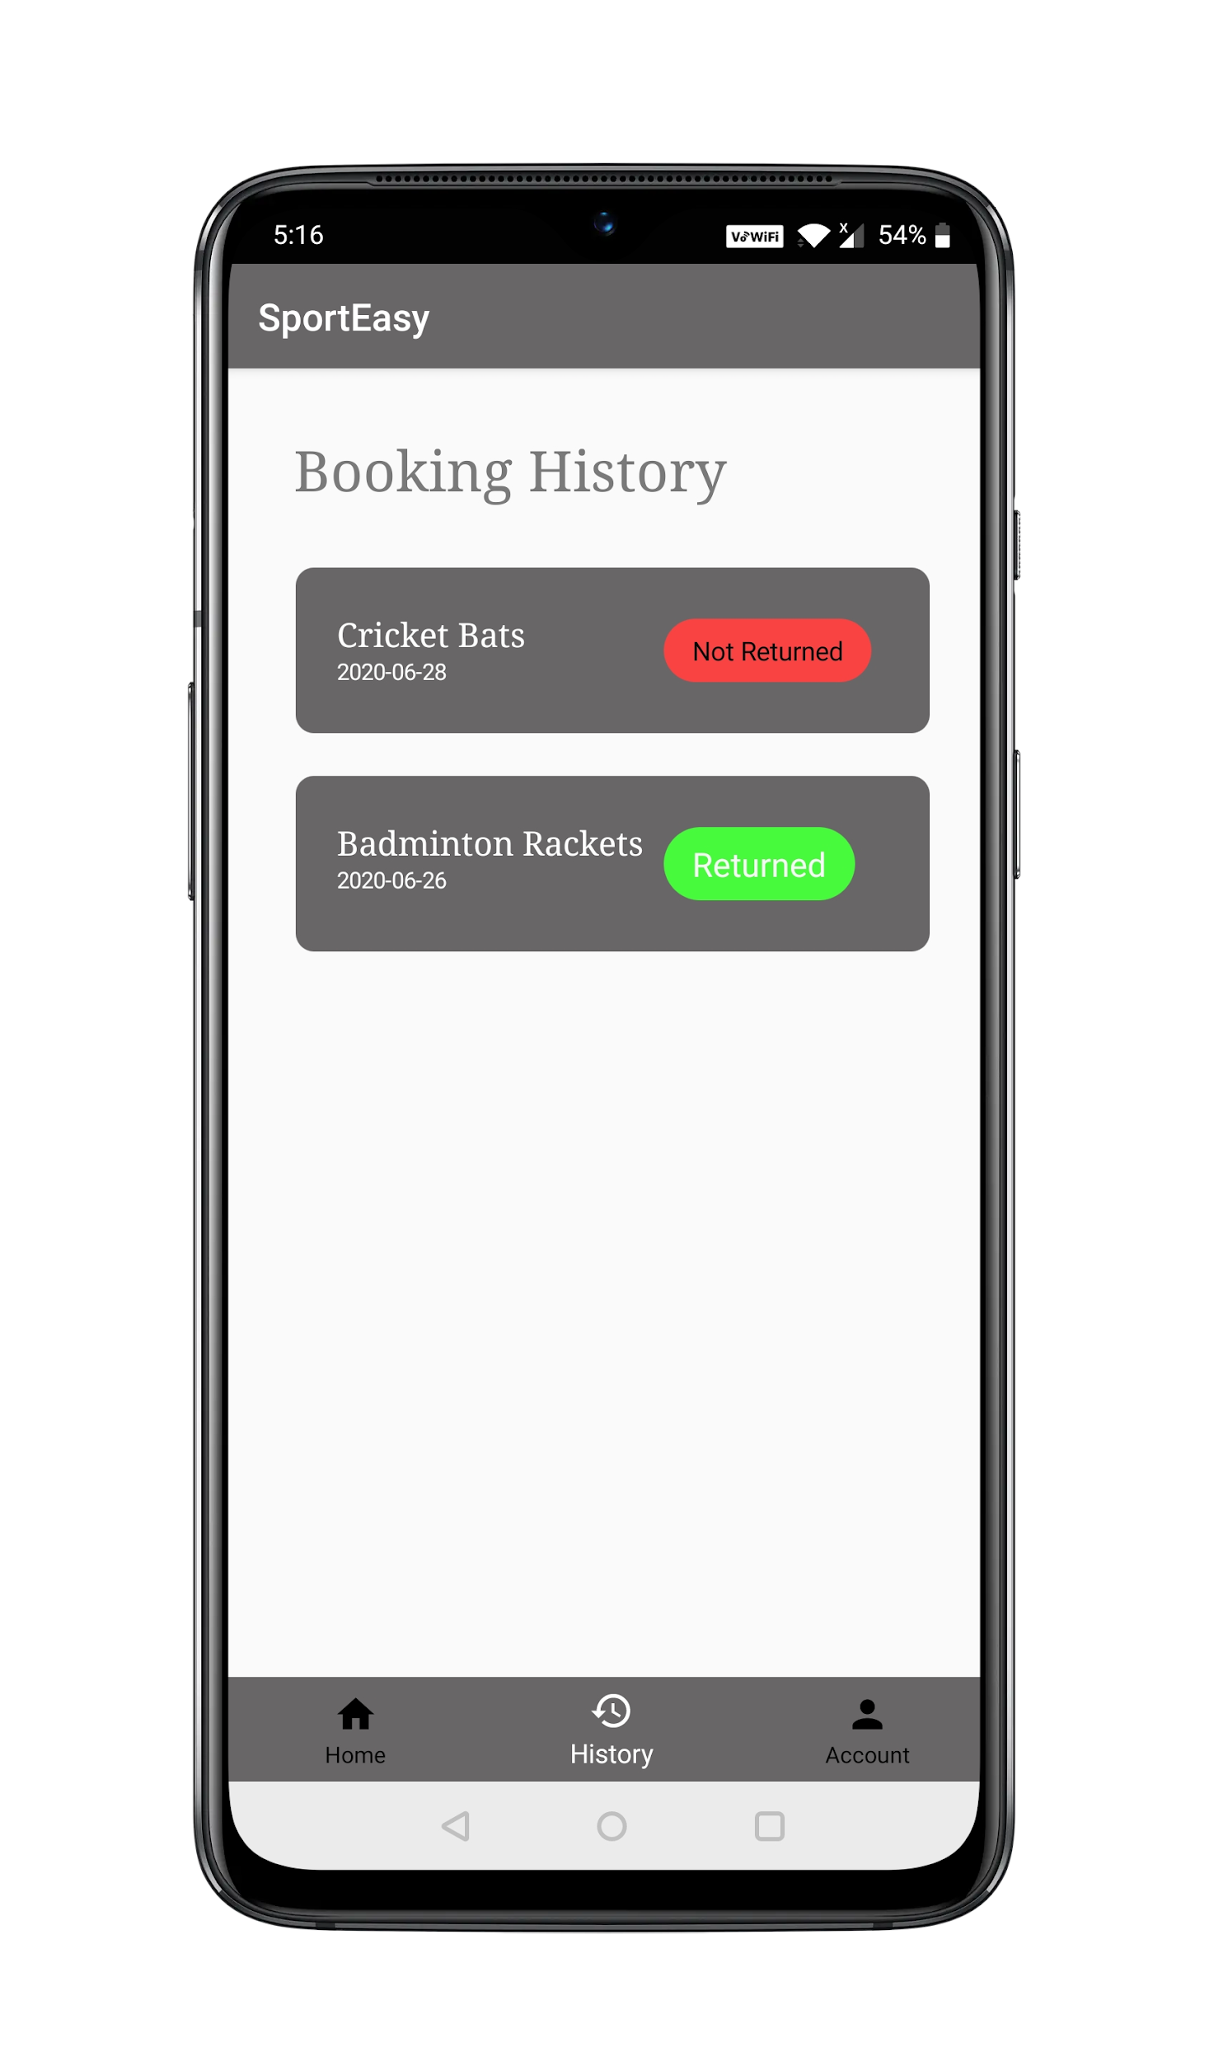
Booking
History
User gets to see all his previous bookings and their status.

Slide 31
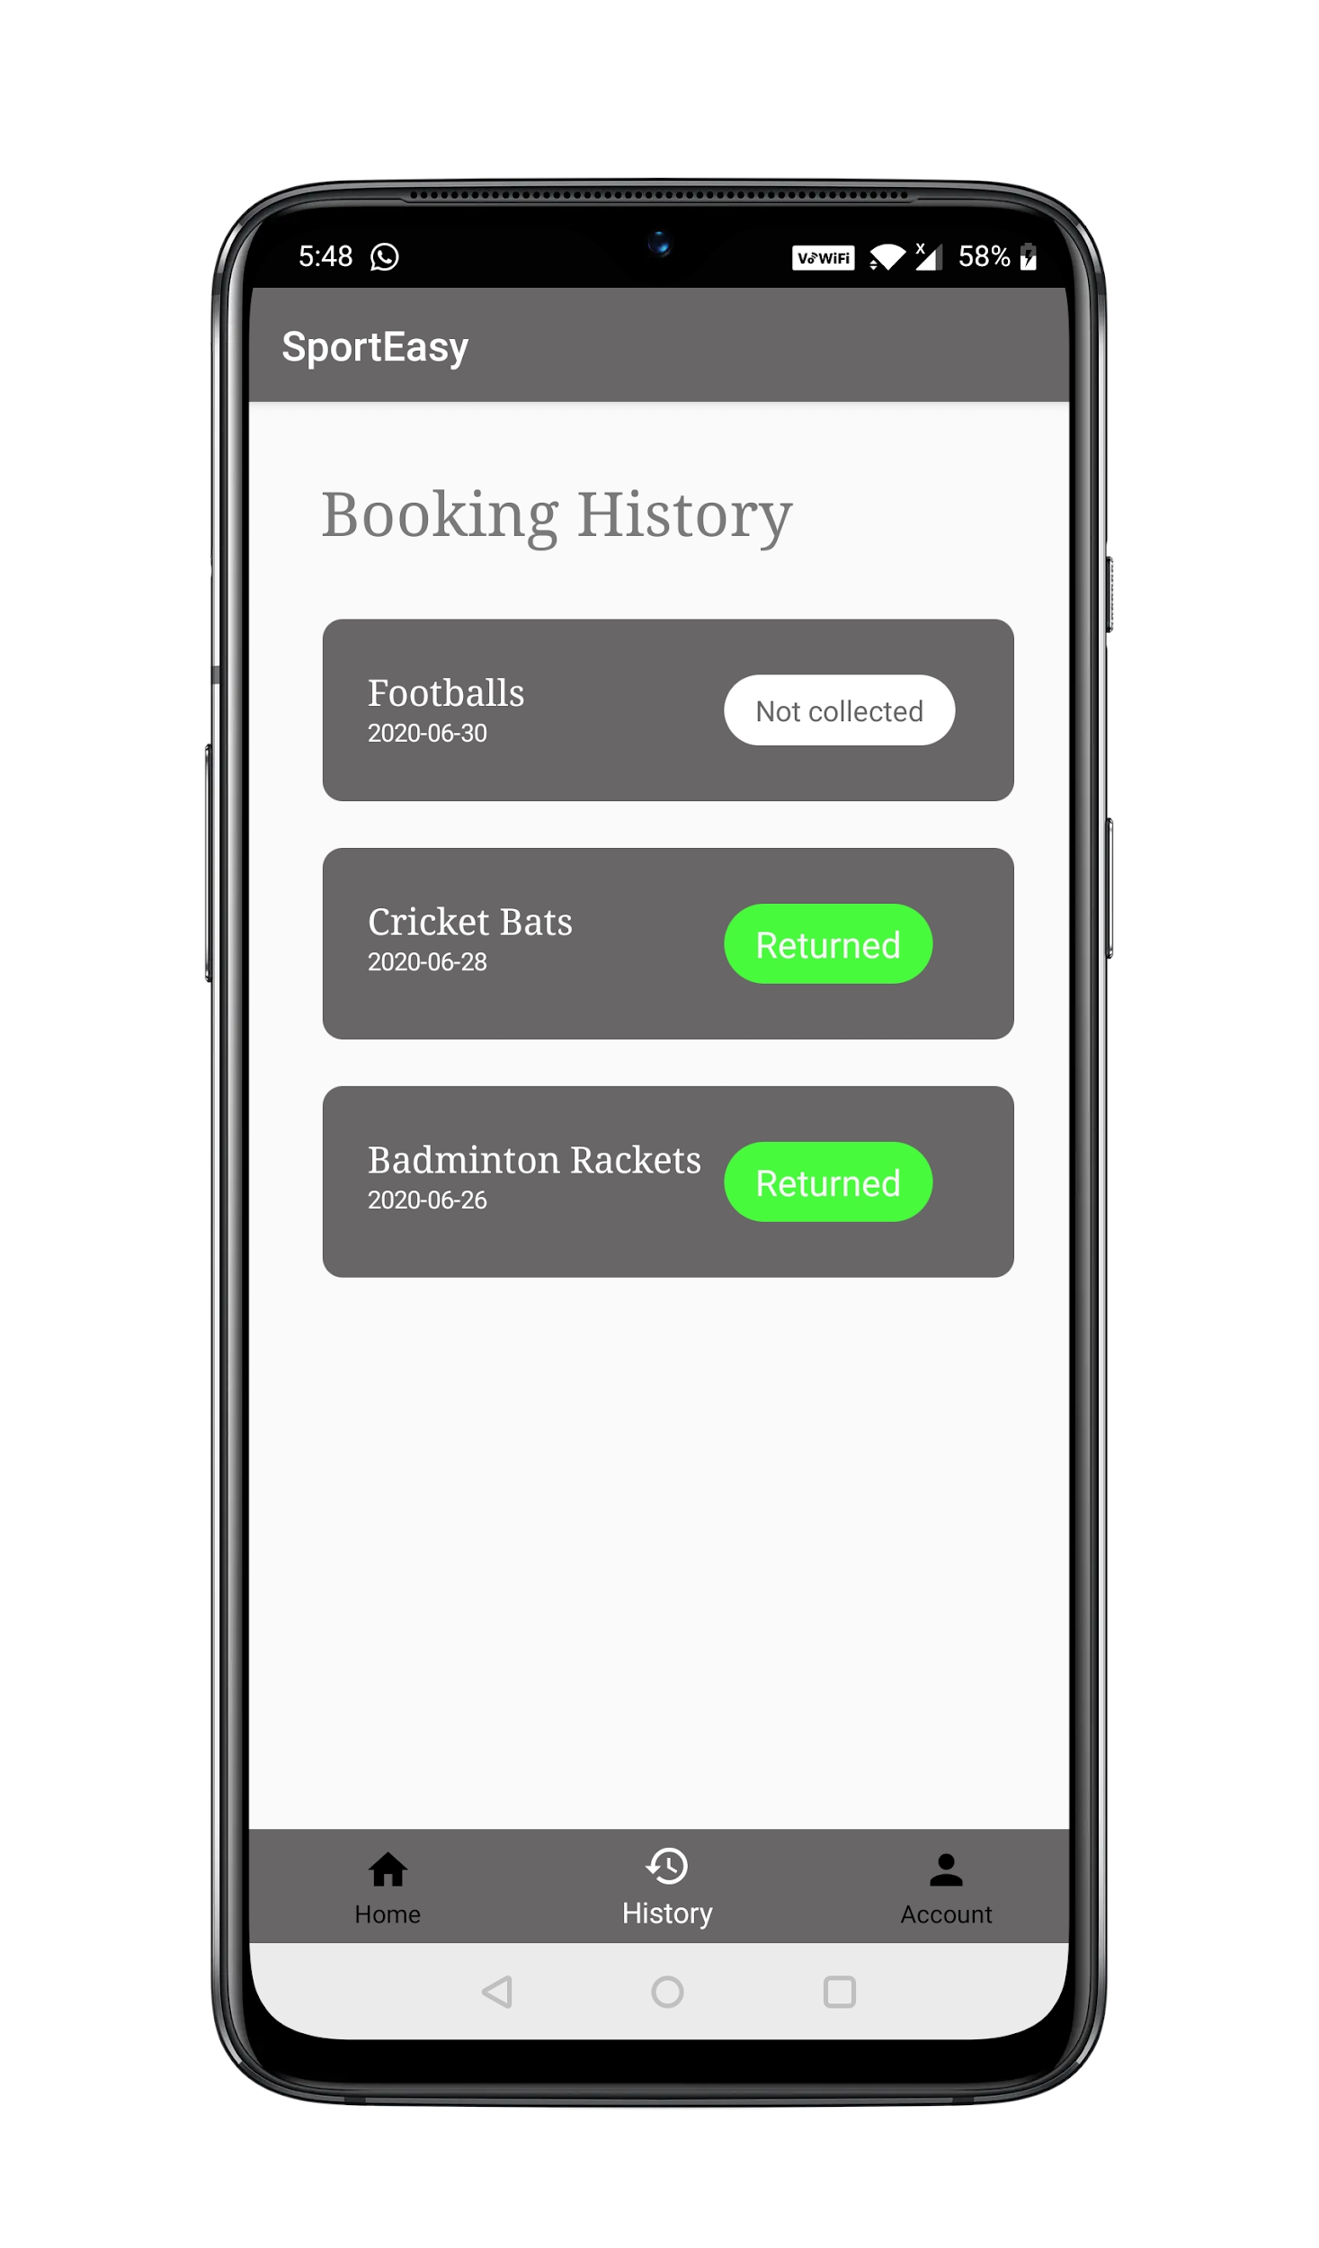
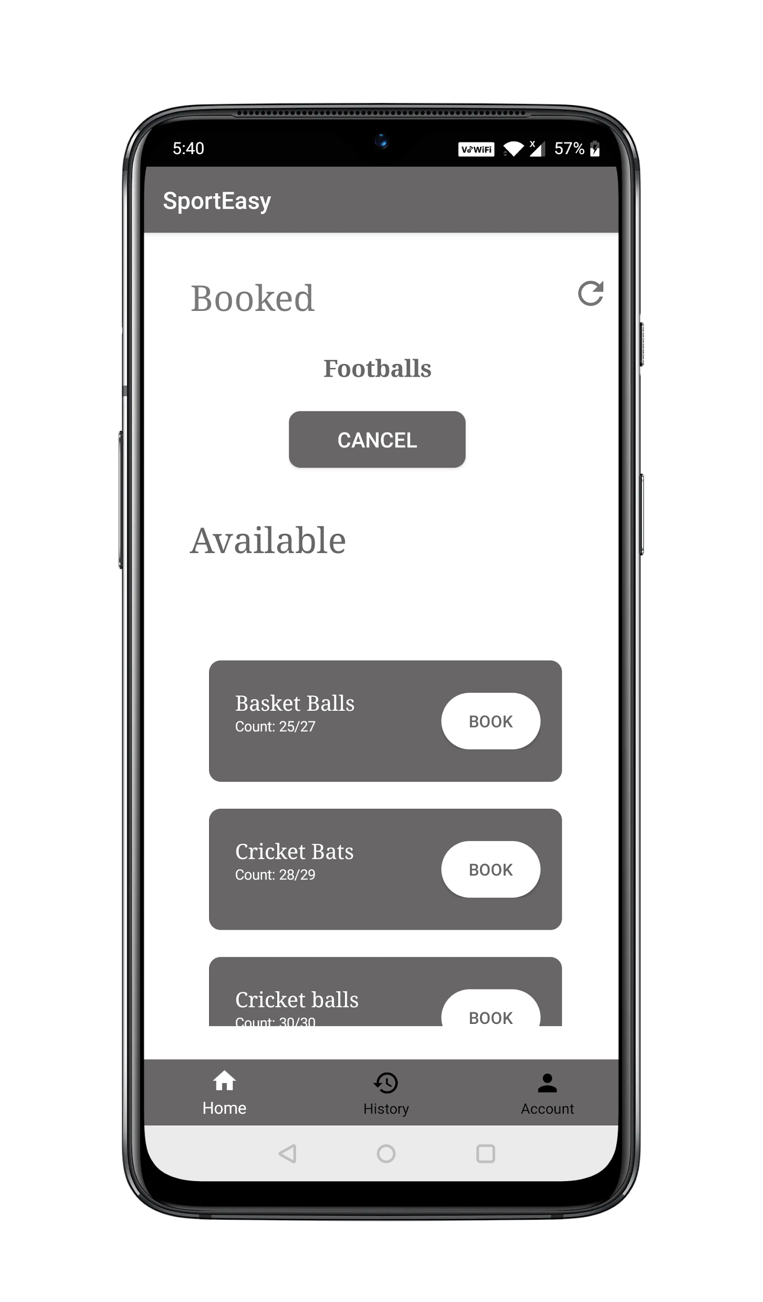
API ENDPOINTS USED IN MOBILE APPLICATION
/userBookingLog
Returns the details of the booking of current day
/allBookings
Returns the booking details of a user along with the status
Details of the bookings which are not returned or returned or nor yet collected
/resourcesPresent(GET)
Fetches the details of all the resources present

Slide 32
A API ENDPOINTS USED IN MOBILE APPLICATION
/cancelBooking
User can cancel a booking request within 20 minutes from the time of booking and if the resource is not collected yet.
/bookResources
User can book a resource if he doesn’t have any fine imposed
User can only book between 11:40a.m and 3:00pm
User can only book once a day
User cannot book if any resource is returned yet.

Slide 33
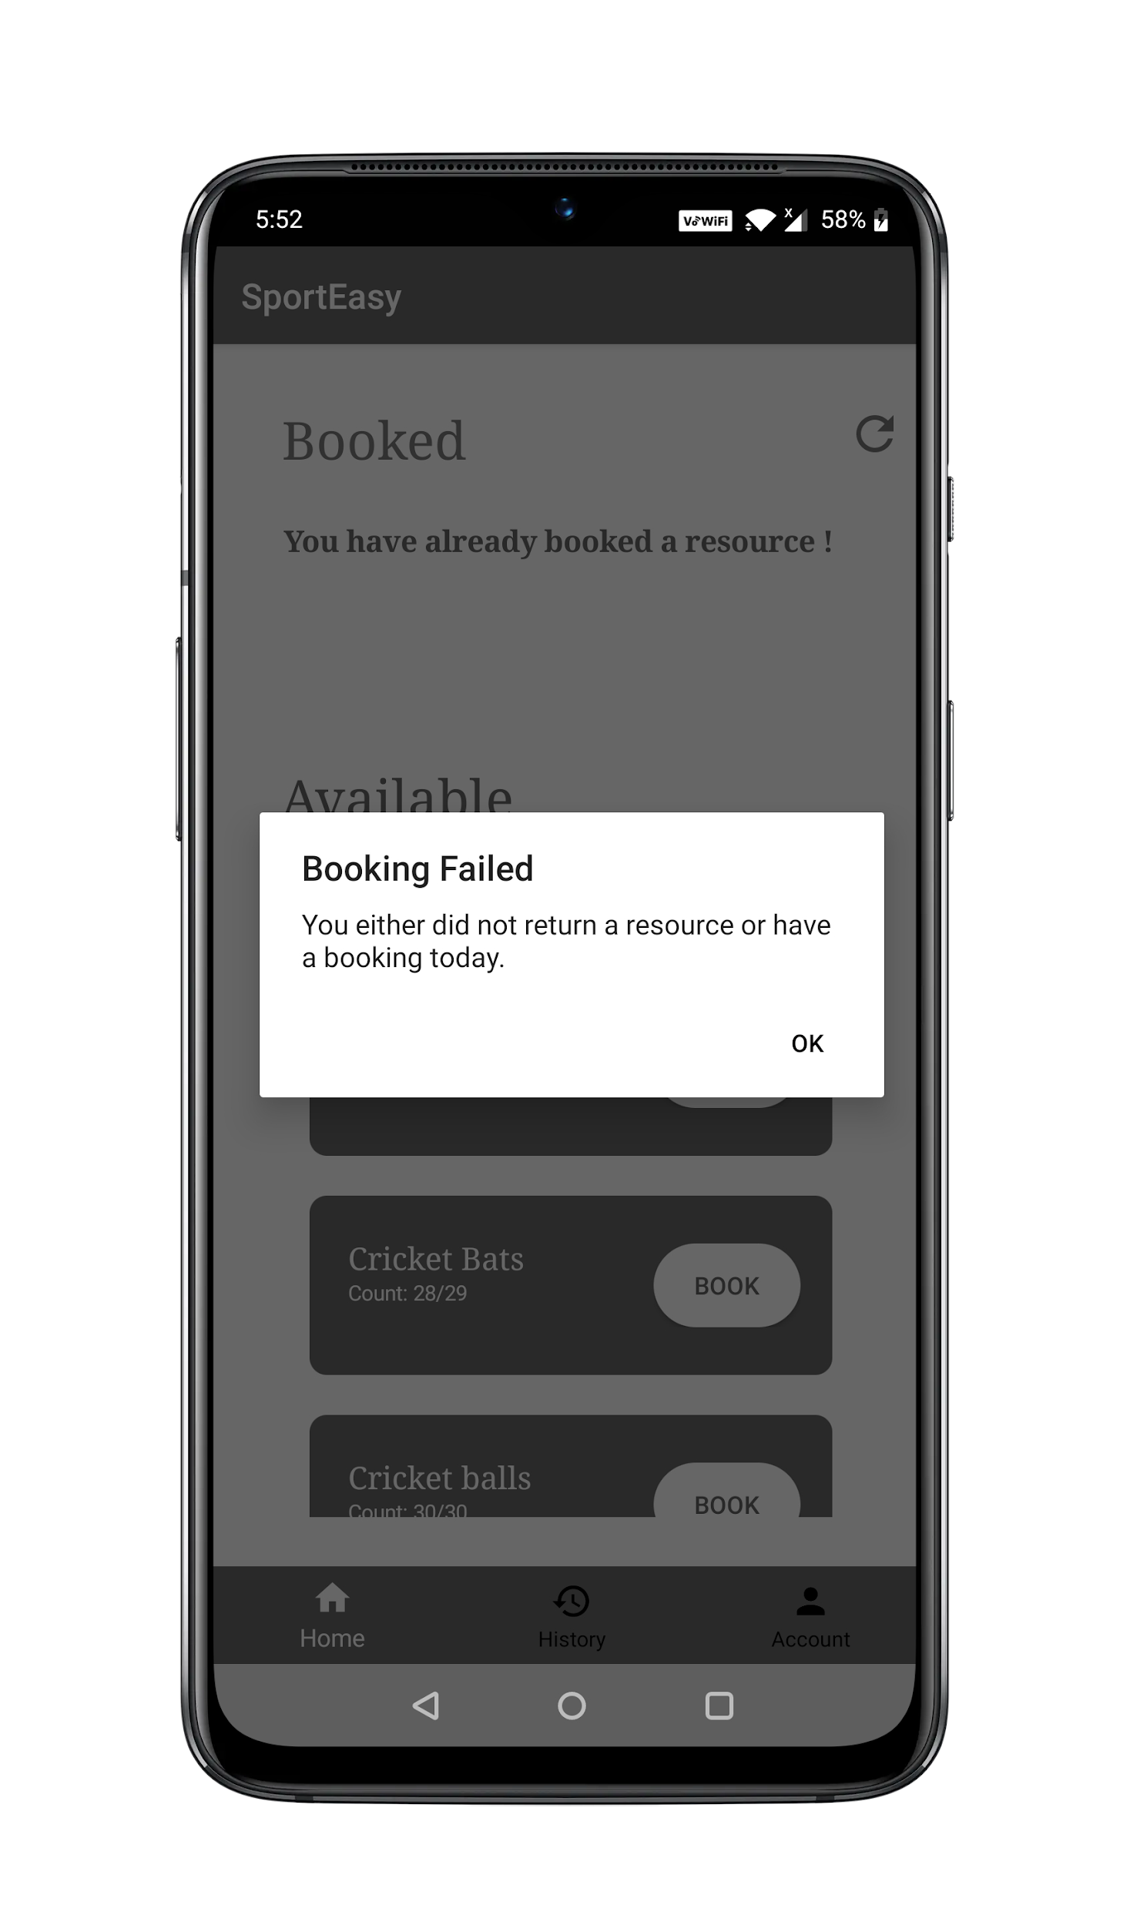
User doesn’t get to book a new resource until he returns the previously booked one.

Slide 34
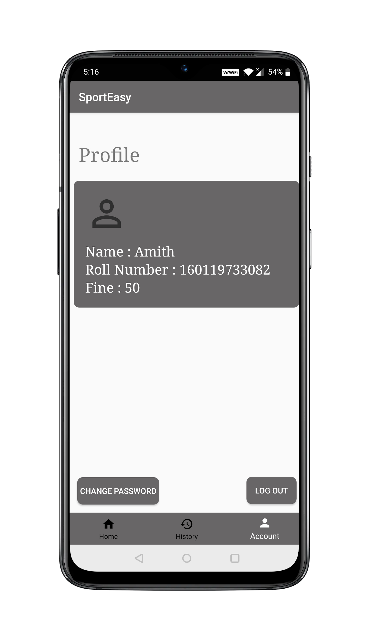
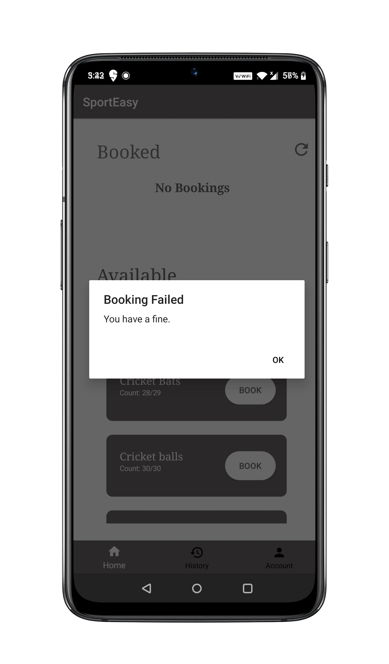
Fine
A fine imposed restricts the user to make any further bookings.

Slide 35
Profile
The user can view his details and can know the fine imposed on him if any.

Slide 36
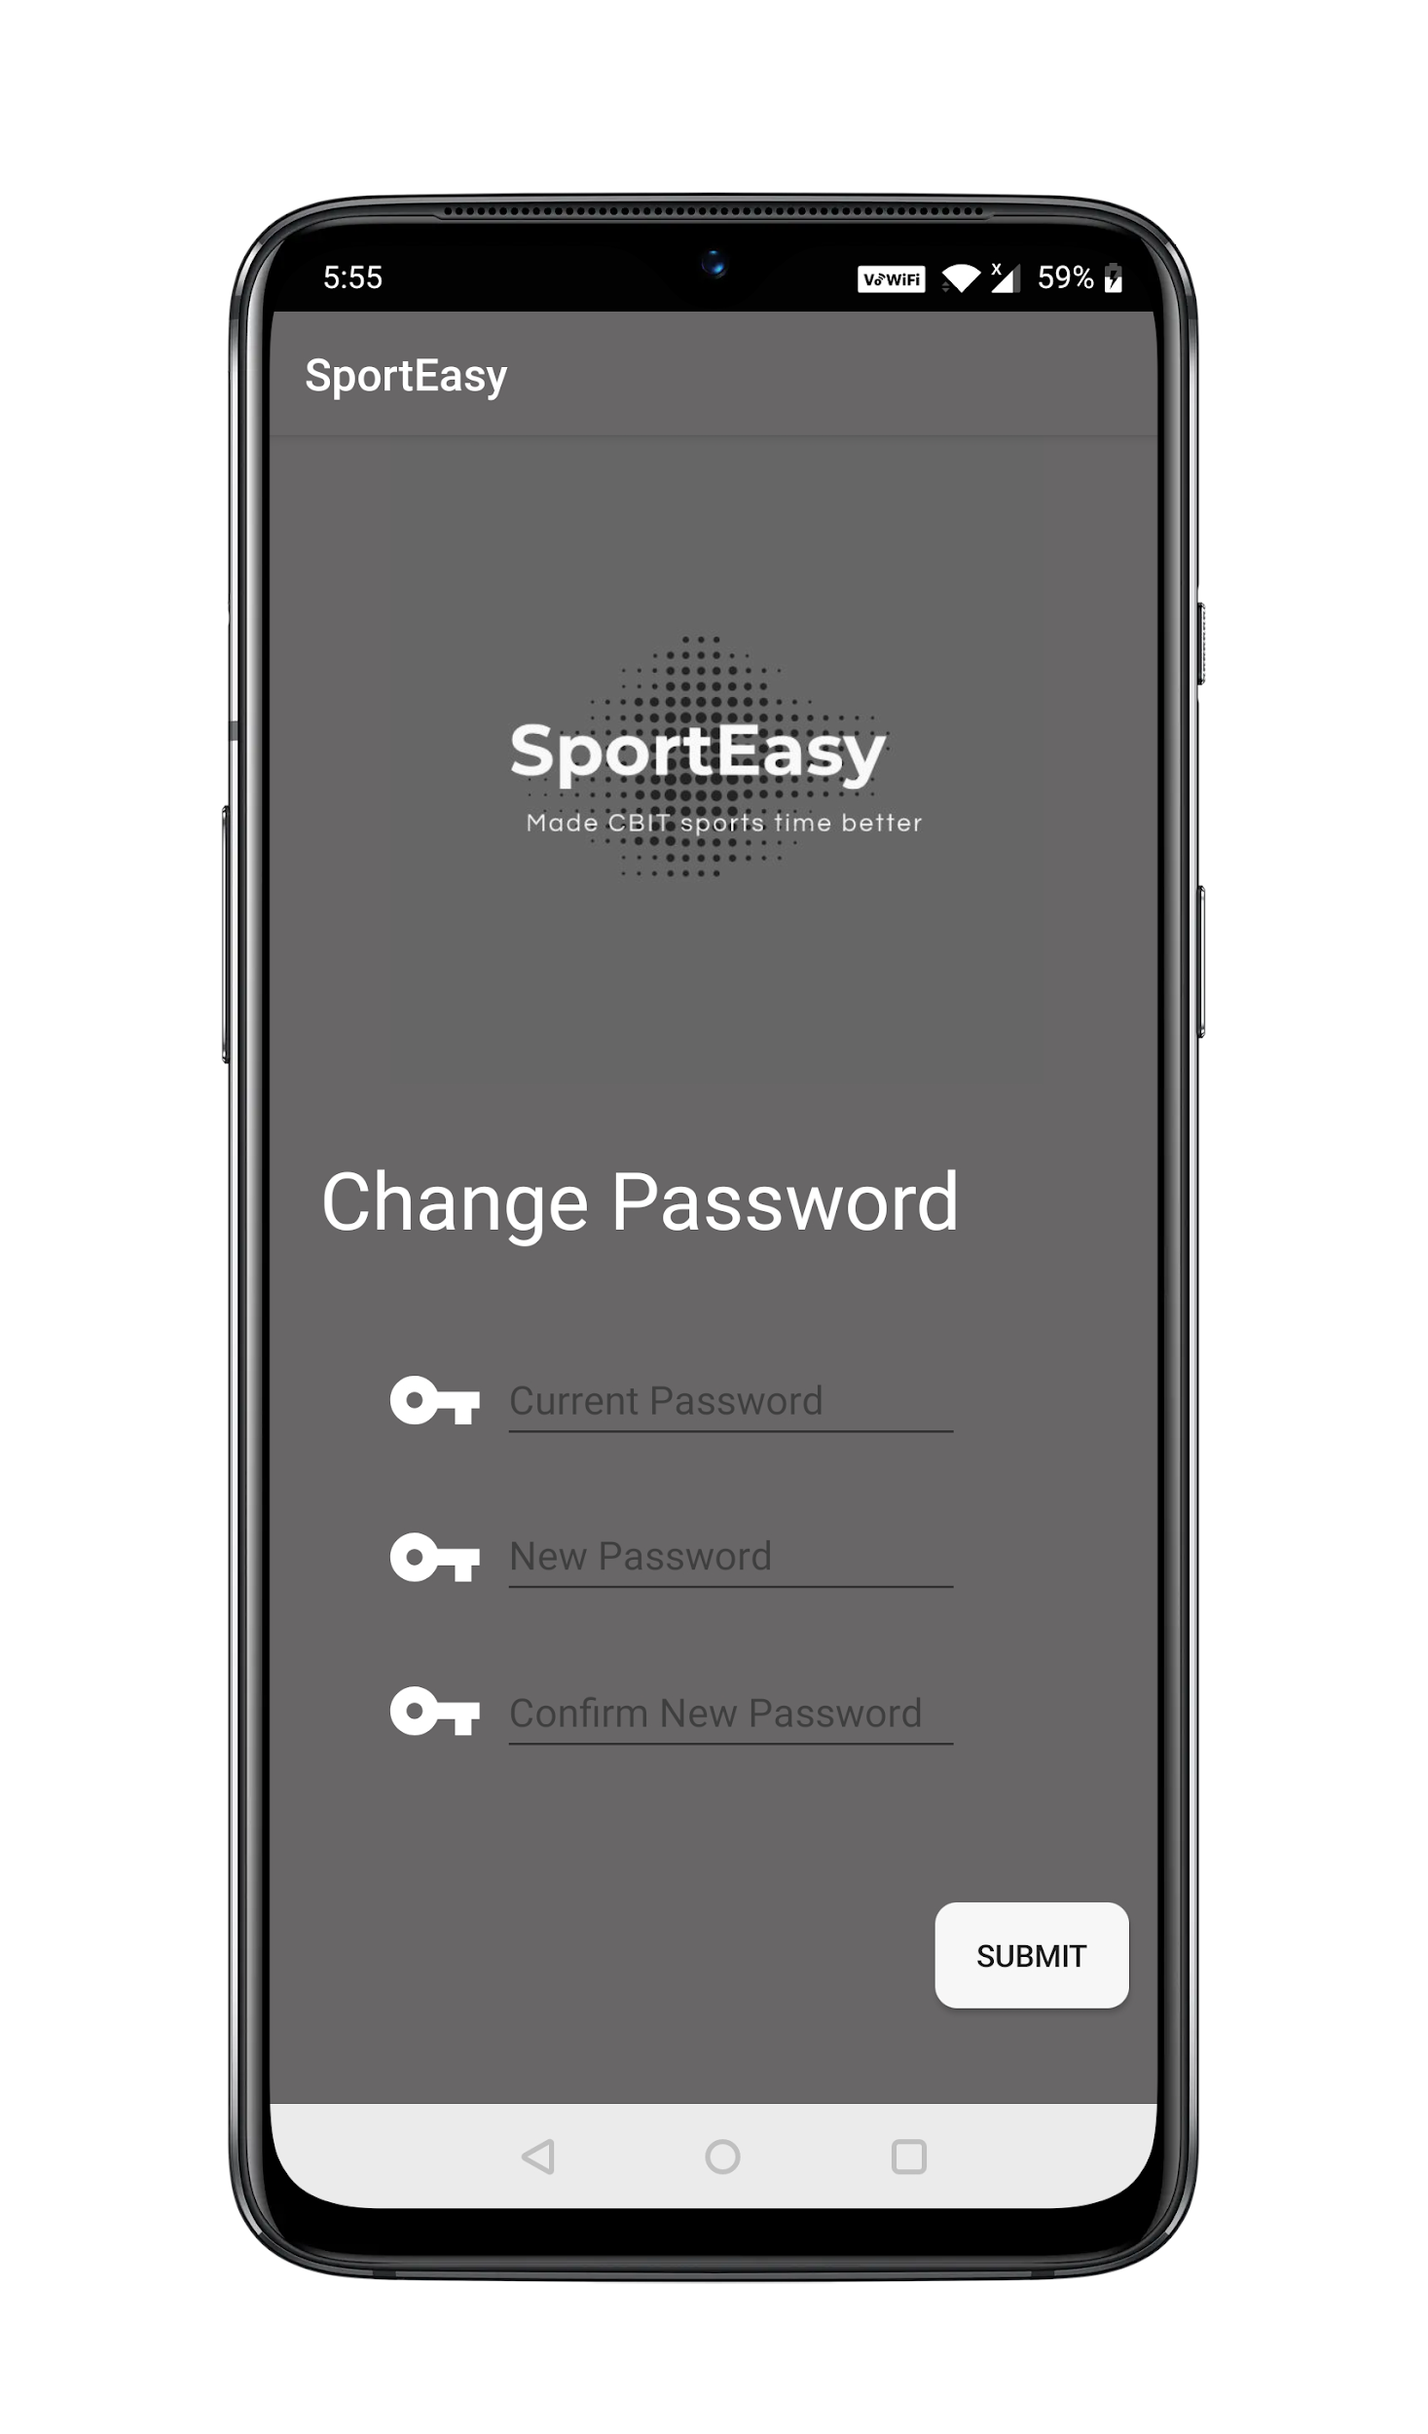
Change Password
A user can change his password by confirming his current password.

Slide 37
API ENDPOINTS USED IN USER PROFILE PAGE
/users
Returns the data of a particular user from the database.
/change_password
User can change their password using id,old password and new password.

Slide 38
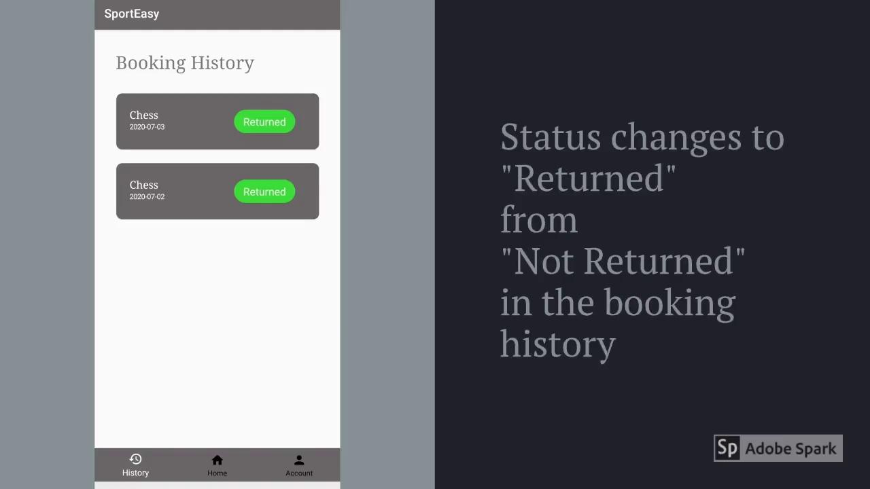

Slide 39
Future Scope
This application can be enhanced by including numerous new features :
In the future, the app can be developed which itself detects whether the student is having a free hour or not, thereby eliminating the involvement of the admin.
In case of unavailability of a resource, a “notify when available” button could be included too.
Subsequently, a separate page linked to admin webpage could also be developed, where the admin can add updates about upcoming sports events or competitions in such a way that these updates will also be visible in the mobile app for students.
We can also include a feature such that the admin can send notifications to the user regarding the fine to be cleared.

Slide 40
THANK YOU

Slide 41

Booking a Resource
A user can book any one of the resources displayed.He will also have an option to cancel his booking with in 20 minutes of the booking time

Slide 42
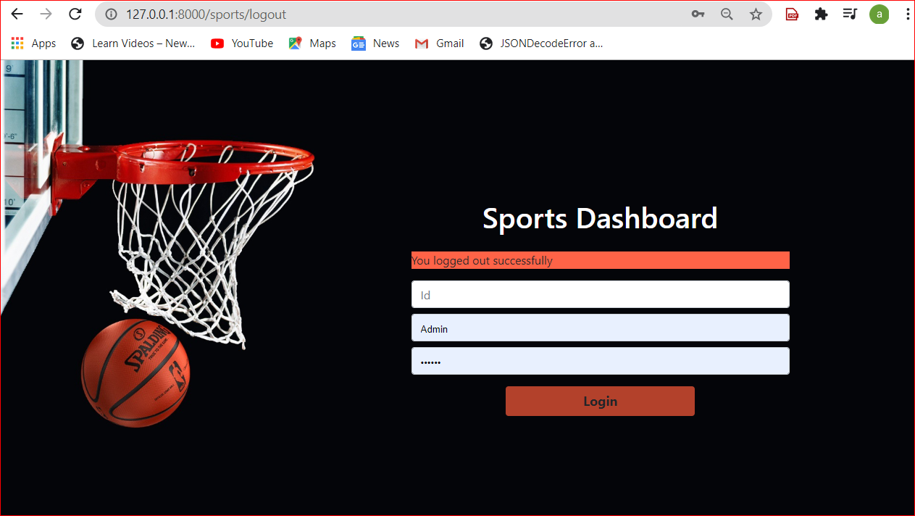
Admin Logout: After clicking logout in the home page, this page is viewed which contains the message “You logged out successfully” .The admin can login again if he wants to view anything.

